Slide 1
Design process
SOFTWARE ENGINEERING
SPRING 2021

Slide 2
What is design?
Software design encompasses the set of principles, concepts, and practices that lead to the development of a high-quality system or product.
Design is what almost every engineer wants to do. It is the place where creativity rules—where stakeholder requirements, business needs, and technical considerations all come together in the formulation of a product or system. Design creates a representation or model of the software, but unlike the requirements model (that focuses on describing required data, function, and behavior), the design model provides detail about software architecture, data structures, interfaces, and components that are necessary to implement the system.

Slide 3
Why is it important?
Design allows you to model the system or product that is to be built. This model can be assessed for quality and improved before code is generated, tests are conducted, and end users become involved in large numbers. Design is the place where software quality is established.

Slide 4
Software architecture
Software architecture refers to the fundamental structures of a software system and the discipline of creating such structures and systems. Each structure comprises software elements, relations among them, and properties of both elements and relations.
Software architecture is, simply, the organization of a system. This organization includes all components, how they interact with each other, the environment in which they operate, and the principles used to design the software. In many cases, it can also include the evolution of the software into the future.

Slide 5
Steps
Design depicts the software in a number of different ways. First, the architecture of the system or product must be represented. Then, the interfaces that connect the software to end users, to other systems and devices, and to its own constituent components are modeled. Finally, the software components that are used to construct the system are designed. Each of these views represents a different design action, but all must conform to a set of basic design concepts that guide software design work.

Slide 6
Work product
A design model that encompasses architectural, interface, component level, and deployment representations is the primary work product that is produced during software design.

Slide 7
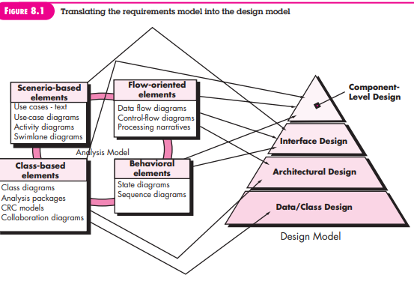
Translating requirements model into design model

Slide 8
The design process
Software design is an iterative process through which requirements are translated into a “blueprint” for constructing the software. Initially, the blueprint depicts a holistic view of software. That is, the design is represented at a high level of abstraction— a level that can be directly traced to the specific system objective and more detailed data, functional, and behavioral requirements. As design iterations occur, subsequent refinement leads to design representations at much lower levels of abstraction. These can still be traced to requirements, but the connection is more subtle

Slide 9
Software Quality Guidelines and Attributes
Throughout the design process, the quality of the evolving design is assessed with a series of technical.
McGlaughlin [McG91] suggests three characteristics that serve as a guide for the evaluation of a good design:
The design must implement all of the explicit requirements contained in the requirements model, and it must accommodate all of the implicit requirements desired by stakeholders.
The design must be a readable, understandable guide for those who generate code and for those who test and subsequently support the software.
The design should provide a complete picture of the software, addressing the data, functional, and behavioral domains from an implementation perspective.

Slide 10
How design goals are achieved?
Through Quality Guidelines
Through Quality Attributes [Hewlett-Packard [Gra87] developed a set of software quality attributes that has been given the acronym FURPS—functionality, usability, reliability, performance, and supportability. The FURPS quality attributes represent a target for all software design]

Slide 11
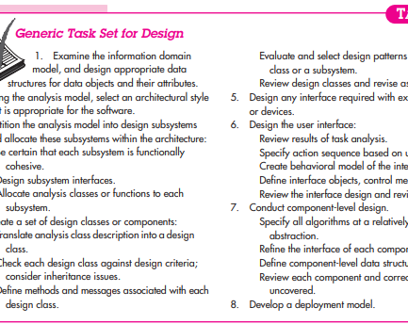
TASK SET FOR DESIGN

Slide 12
Design concepts
A set of fundamental software design concepts has evolved over the history of software engineering. Although the degree of interest in each concept has varied over the years, each has stood the test of time. Each provides the software designer with a foundation from which more sophisticated design methods can be applied. Each helps you answer the following questions:
What criteria can be used to partition software into individual components?
How is function or data structure detail separated from a conceptual representation of the software?
What uniform criteria define the technical quality of a software design?

Slide 13
Design concepts
Abstraction
Architecture
Patterns
Separation of Concerns
Modularity
Information Hiding
Functional Independence
Refinement
Aspects
Refactoring
Object-Oriented Design Concepts
Design Classes

Slide 14
ABSTRACTION
Modular approach → involves many levels of abstraction
At the highest level of abstraction, a solution is stated in broad terms using the language of the problem environment. At lower levels of abstraction, a more detailed description of the solution is provided.
As different levels of abstraction are developed, you work to create both procedural and data abstractions.
A procedural abstraction refers to a sequence of instructions that have a specific and limited function. The name of a procedural abstraction implies these functions, but specific details are suppressed. An example of a procedural abstraction would be the word open for a door. Open implies a long sequence of procedural steps (e.g., walk to the door, reach out and grasp knob, turn knob and pull door, step away from moving door, etc.).
A data abstraction is a named collection of data that describes a data object. In the context of the procedural abstraction open, we can define a data abstraction called door. Like any data object, the data abstraction for door would encompass a set of attributes that describe the door (e.g., door type, swing direction, opening mechanism, weight, dimensions). It follows that the procedural abstraction open would make use of information contained in the attributes of the data abstraction door.

Slide 15
Architecture
Architecture is the structure or organization of program components (modules), the manner in which these components interact, and the structure of data that are used by the components.
In a broader sense, however, components can be generalized to represent major system elements and their interactions.

Slide 16
Patterns
A design pattern describes a design structure that solves a particular design problem within a specific context and amid “forces” that may have an impact on the manner in which the pattern is applied and used.

Slide 17
Separation of Concerns
Separation of concerns is a design concept that suggests that any complex problem can be more easily handled if it is subdivided into pieces that can each be solved and/or optimized independently.
A concern is a feature or behavior that is specified as part of the requirements model for the software. By separating concerns into smaller, and therefore more manageable pieces, a problem takes less effort and time to solve.

Slide 18
modularity
Modularity is the most common manifestation of separation of concerns. Software is divided into separately named and addressable components, sometimes called modules, that are integrated to satisfy problem requirements.

Slide 19
Information Hiding
The principle of information hiding [Par72] suggests that modules be “characterized by design decisions that (each) hides from all others.” In other words, modules should be specified and designed so that information (algorithms and data) contained within a module is inaccessible to other modules that have no need for such information.
Hiding implies that effective modularity can be achieved by defining a set of independent modules that communicate with one another only that information necessary to achieve software function.

Slide 20
Functional Independence
Functional independence in software engineering means that when a module focuses on a single task, it should be able to accomplish it with very little interaction with other modules. In software engineering, if a module is functionally independent of other module then it means it has high cohesion and low coupling.
Coupling shows the relationships between modules. Cohesion shows the relationship within the module. Coupling shows the relative independence between the modules. Cohesion shows the module's relative functional strength. While creating, you should aim for low coupling, i.e., dependency among modules should be less.

Slide 21
Refinement
Refinement is actually a process of elaboration. You begin with a statement of function (or description of information) that is defined at a high level of abstraction. That is, the statement describes function or information conceptually but provides no information about the internal workings of the function or the internal structure of the information. You then elaborate on the original statement, providing more and more detail as each successive refinement (elaboration) occurs.
Abstraction and refinement are complementary concepts. Abstraction enables you to specify procedure and data internally but suppress the need for “outsiders” to have knowledge of low-level details. Refinement helps you to reveal low-level details as design progresses. Both concepts allow you to create a complete design model as the design evolves

Slide 22
Aspects
As requirements analysis occurs, a set of “concerns” is uncovered. These concerns “include requirements, use cases, features, data structures, quality-of-service issues, variants, intellectual property boundaries, collaborations, patterns and contracts”.
An aspect is a representation of a crosscutting concern.
Consider two requirements, A and B. Requirement A crosscuts requirement B “if a software decomposition [refinement] has been chosen in which B cannot be satisfied without taking A into account”.

Slide 23
Aspects - example
For example, consider two requirements for the SafeHomeAssured.com WebApp. Requirement A is described via the ACS-DCV use case. A design refinement would focus on those modules that would enable a registered user to access video from cameras placed throughout a space. Requirement B is a generic security requirement that states that a registered user must be validated prior to using SafeHomeAssured.com. This requirement is applicable for all functions that are available to registered SafeHome users. As design refinement occurs, A* is a design representation for requirement A and B* is a design representation for requirement B. Therefore, A* and B* are representations of concerns, and B* crosscuts A*.
Therefore, the design representation, B*, of the requirement a registered user must be validated prior to using SafeHomeAssured.com, is an aspect of the SafeHome WebApp.

Slide 24
Refactoring
An important design activity suggested for many agile methods, refactoring is a reorganization technique that simplifies the design (or code) of a component without changing its function or behavior.
Fowler [Fow00] defines refactoring in the following manner: “Refactoring is the process of changing a software system in such a way that it does not alter the external behavior of the code [design] yet improves its internal structure.”

Slide 25
Object-oriented design concepts
classes and objects, inheritance, messages, and polymorphism

Slide 26
Design Classes
The requirements model defines a set of analysis classes.
Analysis classes describe some element of the problem domain, focusing on aspects of the problem that are user visible.
The level of abstraction of an analysis class is relatively high.
As the design model evolves, a set of design classes is defined that refine the analysis classes by providing design detail that will enable the classes to be implemented, and implement a software infrastructure that supports the business solution.

Slide 27
Types of Design Classes
Five different types of design classes, each representing a different layer of the design architecture, can be developed [Amb01]:
User interface classes define all abstractions that are necessary for human computer interaction (HCI). In many cases, HCI occurs within the context of a metaphor (e.g., a checkbook, an order form, a fax machine), and the design classes for the interface may be visual representations of the elements of the metaphor.
Business domain classes are often refinements of the analysis classes defined earlier. The classes identify the attributes and services (methods) that are required to implement some element of the business domain.
Process classes implement lower-level business abstractions required to fully manage the business domain classes.

Slide 28
Types of Design Classes
Persistent classes represent data stores (e.g., a database) that will persist beyond the execution of the software.
System classes implement software management and control functions that enable the system to operate and communicate within its computing environment and with the outside world.

Slide 29
Characteristics of WELL-FORMED Design Classes
Complete and sufficient
Primitiveness
High cohesion
Low coupling

Slide 30
Design model – two different dimensions
The process dimension indicates the evolution of the design model as design tasks are executed as part of the software process.
The abstraction dimension represents the level of detail as each element of the analysis model is transformed into a design equivalent and then refined iteratively.

Slide 31
Elements of design model
Data Design Elements
Architectural Design Elements
Interface Design Elements
Component-Level Design Elements
Deployment-Level Design Elements

